Slide 1
Non-Parametric Tests
Part 3

Slide 2
Mann-Whitney Test
Use this when two different groups of participants perform both conditions of your study: i.e., it is appropriate for analyzing the data from an independent-measures design with two conditions.
Use it when the data do not meet the requirements for a parametric test (i.e. if the data are not normally distributed; if the variances for the two conditions are markedly different; or if the data are measurements on an ordinal scale). Otherwise, if the data meet the requirements for a parametric test, it is better to use an independent-measures t-test (also known as a "two-sample" t-test).

Slide 6
Assumptions

Slide 7
Uses of Mann-Whitney
Mann-Whitney U test is can be used for every industry.
But is more frequently used in healthcare, nursing, business, and also many other disciplines.
In medicine, it is a more efficient method to know the effect of two medicines and whether they are equal or not. It is also used to know whether or not a particular medicine cures an ailment or not.

Slide 8
Procedure to conduct Mann-Whitney test
Combine two samples of data together, and sort the data in ascending order
Convert data to ranks
Separate ranks back into two samples
Compute the test statistic, U
Determine the critical value of U from the Mann-Whitney table
Finally, Formulate a decision and conclusion

Slide 9
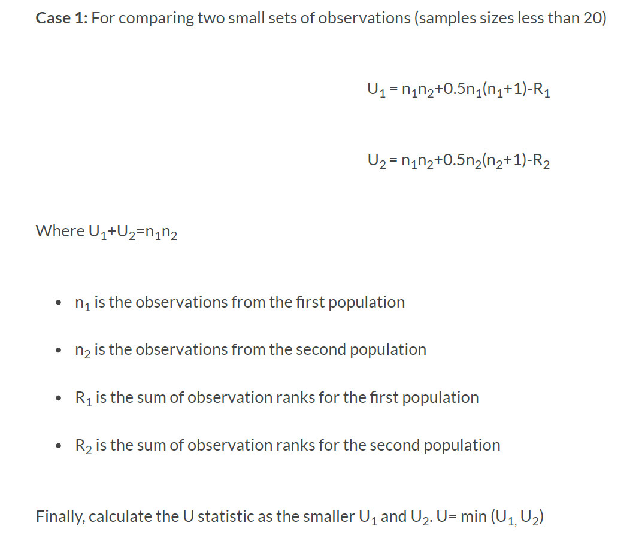
Calculation of Mann-Whitney Test

Slide 10
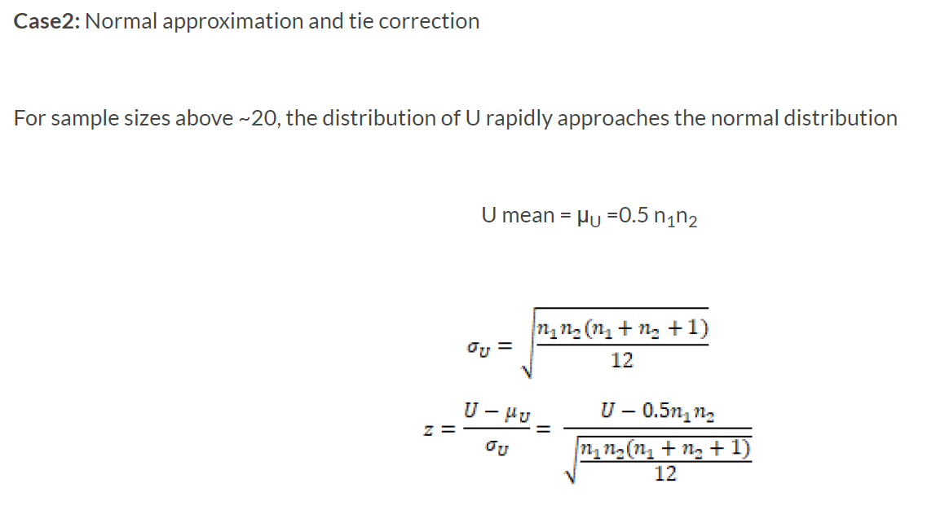

Slide 11
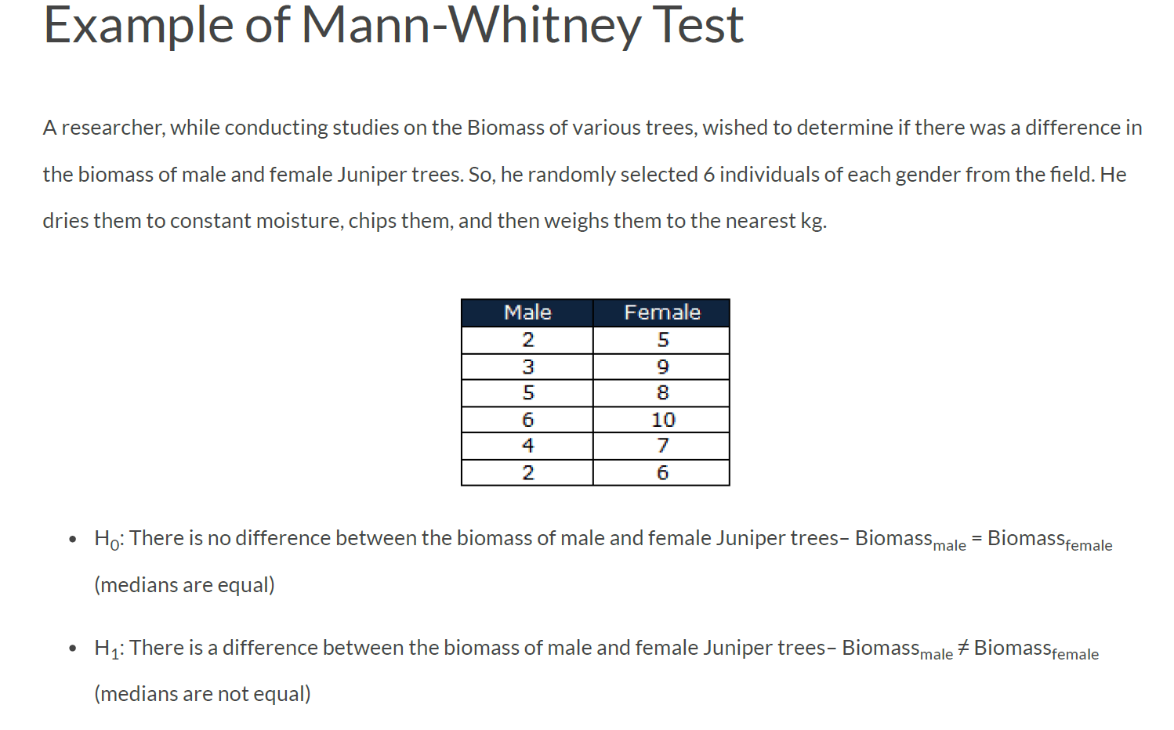

Slide 12
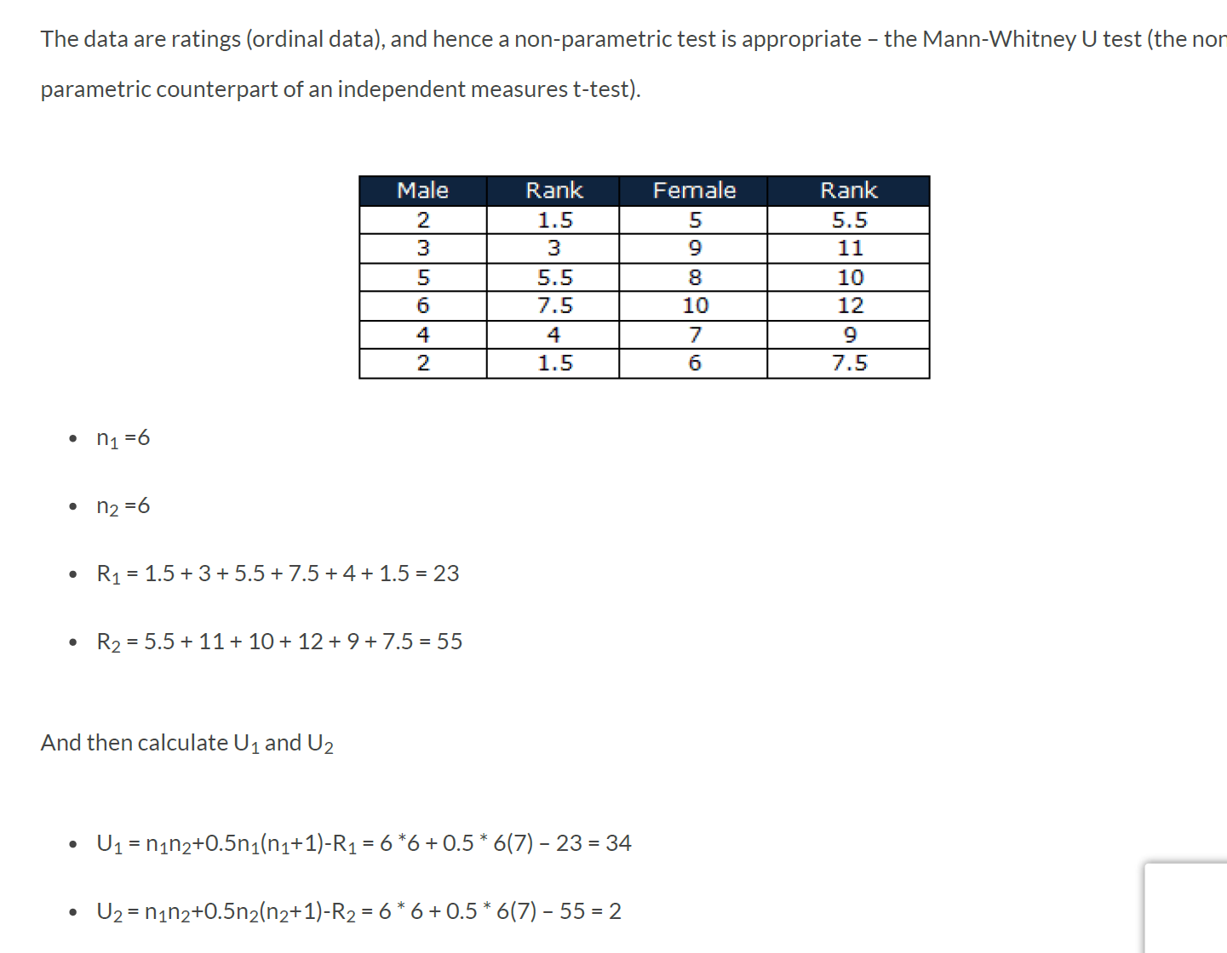


Slide 13
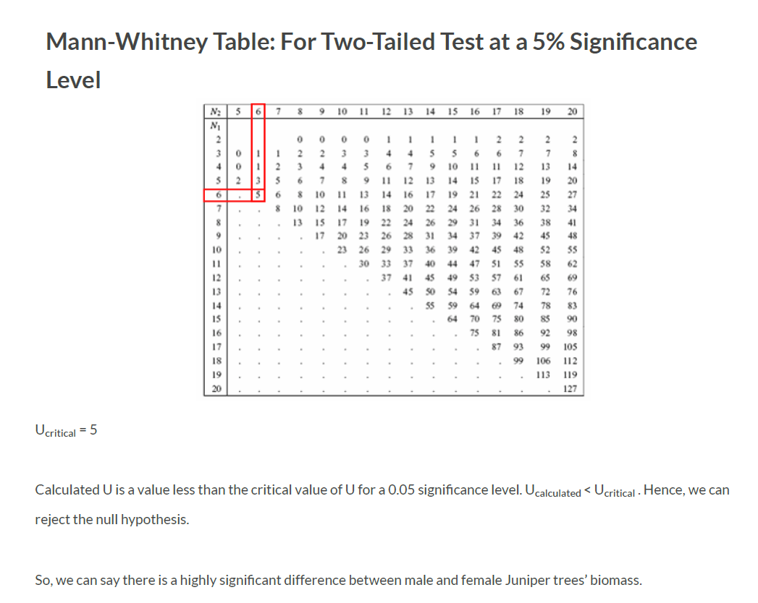

Slide 14
Example

